Slide 1
Why South Carolina D.O.T Should Not Abandon “Lowman Home Barn Road” S 40-216 One of three “Collector Roads” that route traffic to a single Arterial Road “Dutch Fork Road (Hwy-76)
Revision 6, 01/20/2020
Authors: Lou Urschel and Chris Slaughter
Lou’s Cell: (740) 350-5842
Chris’s Cell: (803) 546-2667

Slide 2
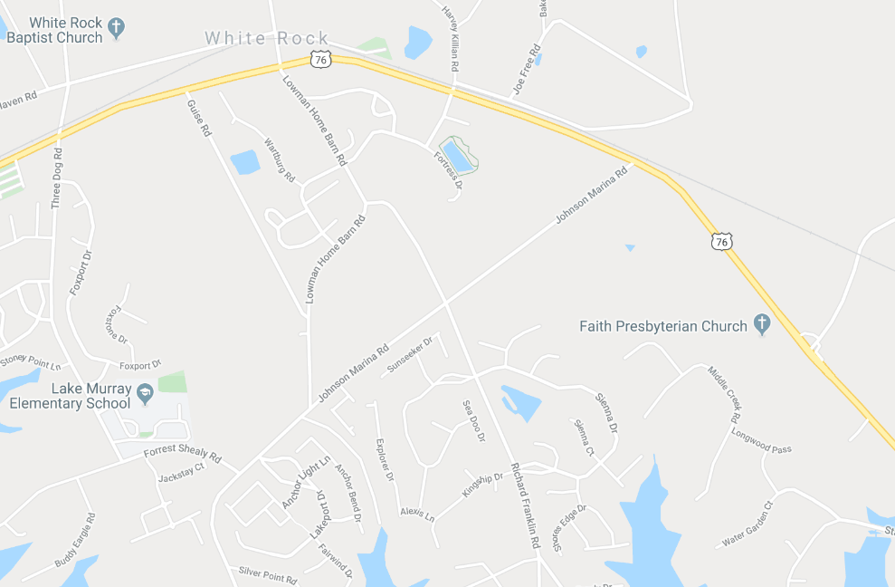
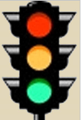
Why South Carolina D.O.T Should Not Abandon “Lowman Home Barn Road” S 40-216 One of three “Collector Roads” that route traffic to a single Arterial Road “Dutch Fork Road (Hwy-76)
Primary Route to Spring Hill High School, Chapin Middle, and CATE Center
Only 3 Connector Roads Handle Traffic For 10 HOAs, + 1500 Properties & 1 Elementary School
0.5 Miles
Lowman Home’s residents represent less then 5% of the community served by the three “Connector Roads.”
0.7 Miles
Guise Road
Reformation Rd.
Three Dog Rd.
US-76 (Dutch Fork Rd.)
Rauch Metz Rd.
Johnson Marina Rd.
0.6 Miles
Lowman Home Barn Rd.
Lake Murray
Elementary School
Forrest Shealy Rd.

Slide 3
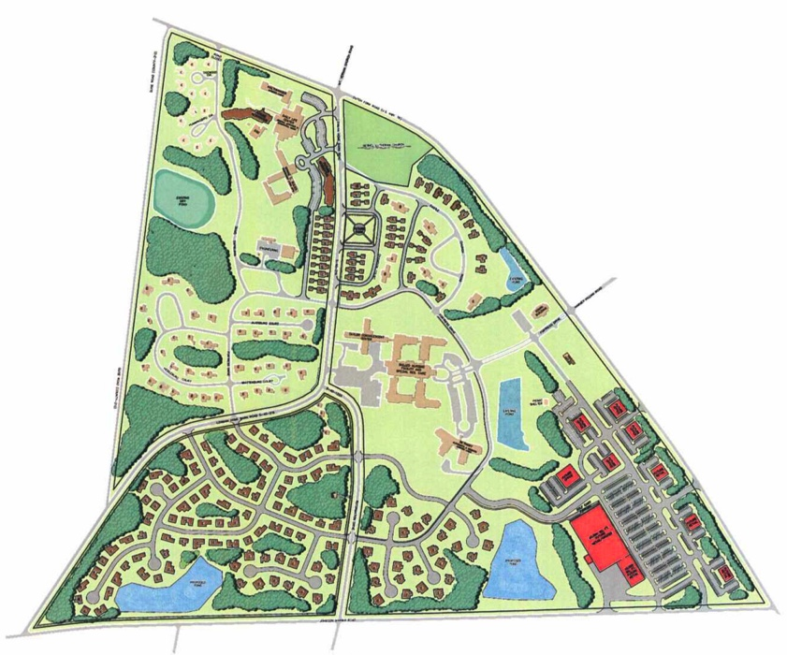
Why South Carolina D.O.T. Should Not Abandon “Lowman Home Barn Road” S 40-216. One of three “Collector Roads” that route traffic to a single Arterial Road “Dutch Fork Road (Hwy-76) Lowman Home Master Plan (2007)
Existing
Development
Existing
Development
US-76 (Dutch Fork Road)
2 Exits to US-76
Commercial
Development (10 New Stores)
Residential Development
Residential Development
(205 New Patio Homes)
Lowman Home Barn Road
Reformation Road
3 Exits to Johnson Marina Rd.
Commercial Development
1 100,000 sq ft Retail Building
9 Commercial Buildings that can be up to 12,000 sq ft each
Johnson Marina Road

Slide 4
Why South Carolina D.O.T. Should Not Abandon “Lowman Home Barn Road” S 40-216. One of three “Collector Roads” that route traffic to a single Arterial Road “Dutch Fork Road (Hwy-76)
More peninsula community members, including children, will be involved in accidents
Increased traffic congestion on Johnson Marina, Forrest Shealy & Three Dog Roads
Forrest Shealy Road does not meet current state road specifications
Inadequate 40-foot Left turn lane on Johnson Marina Road (A School Bus is 45 feet long)
Emergency event response time could be slower
Emergency egress from our peninsula would take longer
The planned “Fresh Church” 19.4-acre development will add to congestion
Lowman Home has some risk reduction actions already in place and more can be made available without closure of the roads
Significant acreage still on peninsula for development
SCDOT’s Quid-Pro-Quo traffic signal at Johnson Marina Road & US-76 is not helpful
Notes:
Share this fact:
Neighbors on Guise Road are not happy with the Lowman Home’s construction of new apartments. They have been blocked in their homes by construction workers multiple times, and do not feel like they are being treated fairly by Lutheran Homes of SC.

Slide 5
Why South Carolina D.O.T. Should Not Abandon “Lowman Home Barn Road” S 40-216. One of three “Collector Roads” that route traffic to a single Arterial Road “Dutch Fork Road (Hwy-76) “New & Improved” US-76 and Johnson Marina Road Intersection
Inadequate 40-foot Left turn lane on Johnson Marina Road (A School Bus is 45 feet long) This lane was added as an afterthought after construction began, and requires a left turn greater than 90 degrees from US-76. This causes many drivers to turn into the Left Turn Lane when turning onto Johnson Marina Road
Out of the picture, at the point where Left Turn Lane is 0’ wide, the Entrance Lane is 15’-10” wide, and the Exit Lane is 18’-3” wide
An over 100 degree turn is required from US-76.
Many drivers accidentally turn into the Left Turn Lane from US-76
Entrance Lane
18’-3” wide
Left Turn Lane
34 ft long and
11’-8” wide
Right Turn Lane
14’-2” wide

Slide 6
Why South Carolina D.O.T. Should Not Abandon “Lowman Home Barn Road” S 40-216. One of three “Collector Roads” that route traffic to a single Arterial Road “Dutch Fork Road (Hwy-76)
SCDOT’s Quid-Pro-Quo to add a traffic signal at Johnson Marina & Hwy-76 is not desirable
Johnson Marina Road Issues if signal added
The Left Turn holding lane is only 40 feet and provides inadequate storage of vehicles
Left Turn holding lane will only hold 90% of the length of one school bus (1 school bus is 45 feet long)
Left Turn holding lane traffic will restrict “Right Turn on Red” flow
Hwy-76 Issues if signal added
Chapin bound Hwy-76 thru traffic will be stopped in a restricted vision turn
Chapin bound Hwy-76 thru traffic will be stopped on a down hill grade
Accident volume will return to the level prior to addition of the Left turn holding lane
Spacing to the Rauch Metz traffic signal is close to design minimum distance (1/2 mile)

Slide 7
Why South Carolina D.O.T. Should Not Abandon “Lowman Home Barn Road” S 40-216. One of three “Collector Roads” that route traffic to a single Arterial Road “Dutch Fork Road (Hwy-76)
More peninsula community members will be involved in accidents if road closed
Lowman Home Barn Road is a primary low congestion and low risk route to Middle School, High School & Technical School
School buses travel Lowman Home Barn Road daily
Alternate High School & Technical School route would require higher risk Left or Right turn off Arterial Hwy-76
Train crossing at Mt. Vernon Church Road at school commute time further backs up traffic on Hwy-76
Accidents on Johnson Marina Road Intersections are already higher than on Lowman Home Barn Road
Alternate route to White Rock Post Office requires Left or Right turn off Arterial Hwy-76
Children walking to Lake Murray Elementary School will be exposed to higher volume of vehicle traffic
Runners/walkers on Johnson Marina, Forrest Shealy and Three Dog will be exposed to more vehicle traffic
Route to closest Gas Station / Convenience Store will require using congested Hwy-76

Slide 8
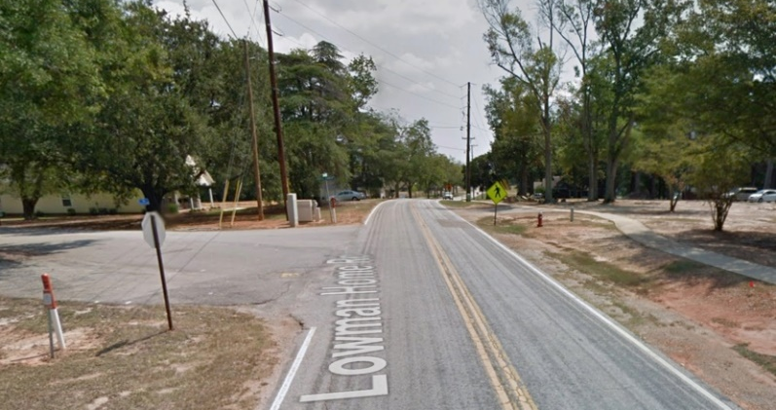
Why South Carolina D.O.T. Should Not Abandon “Lowman Home Barn Road” S 40-216. One of three “Collector Roads” that route traffic to a single Arterial Road “Dutch Fork Road (Hwy-76)
Lowman Home Campus Risk Reduction In Place
25 MPH Speed limit
Three Speed Humps
Risk Reduction Ideas
Stop sign at Castle Church Road intersection
Install sidewalks and golf cart paths on Lowman Home Campus to reduce residents’ need for in-roadway travel
Clearly mark all cross walks
Add flashing lights at 4 way stops
Add cross walk alert lights activated by residents when they need to cross
Change US Mail delivery system (mailboxes) to not require residents to stand on the roadway to retrieve mail
Lowman Homes safety planning deficiencies should not burden the whole community
New homes were built in the last year on Lowman Home Barn Road with no sidewalks
When asked why sidewalks couldn’t be installed now, the CEO of Lutheran Homes of SC responded, “It’s too late now.”
During construction of the patio homes, residents asked about replacement of the sidewalks, but no sidewalks were put in.
Mailboxes abutting the state road are not placed in an ideal location
Lutheran Homes SC sold surrounding property for development without an infrastructure plan.
Lake Murray Elementary School (LMES), Foxport subdivision (142 homes), Osprey subdivision (135 homes), Lakeport subdivision (120 homes) were all built on land formerly owned by Lutheran Homes of SC. (397 homes total)
During LMES construction in the 1990s, new sewer lines were added with taxpayer money, which helped spur additional development of the Lowman Home property, and attracted developers to buy land from the Lowman Home.
STOP
Castle Church Rd.
Lowman Home
Barn Rd.

Slide 9
Why South Carolina D.O.T. Should Not Abandon “Lowman Home Barn Road” S 40-216. One of three “Collector Roads” that route traffic to one Arterial Road “Dutch Fork Road (Hwy-76)
Increase in traffic congestion on Johnson Marina, Forrest Shealy & Three Dog Roads.
Reducing “Collector Roads” by 33% will immediately add significant traffic volume on remaining roads
Congestion at Lake Murray Elementary School at times already blocks portions of two roadways
Berm and center lane parking prevalent now at Lake Murray Elementary School drop off and pick up times
Lake Murray Elementary is over-capacity and using 19 portable classrooms
LMES Enrollment Freeze is in effect for students in this area, so they have to go to Ballentine Elementary
Forrest Shealy Road (S 40-1775) is not paved and marked to current State road standards
No sidewalks on “Connector Roads” for school children to walk to school from adjacent HOAs:
Osprey
Lakeport
Cedar Cove
Foxport
Eden Brook

Slide 10
Why South Carolina D.O.T. Should Not Abandon “Lowman Home Barn Road” S 40-216. One of three “Collector Roads” that route traffic to one Arterial Road “Dutch Fork Road (Hwy-76)
Lutheran Home Campus published & approved development plans will add to current congestion
Retail building maximum size 100,000 sq.ft.
Other commercial buildings up to 12,000 sq.ft.
205 new dwelling units.
New community access points to – Johnson Marina Road = 2, Hwy-76 =2
Planned campus size approximately 205 Acres:
98 acres - single family residences
48 acres – multi-family residences
11 acres - commercial offices
18 acres - commercial retail
30 acres – green space, lawns, woods, wetlands, walkways
Critical “Connector Roads” should never be eliminated in expanding community
60 acres are available on Guise Road for additional development

Slide 11
Why South Carolina D.O.T. Should Not Abandon “Lowman Home Barn Road” S 40-216. One of three “Collector Roads” that route traffic to a single Arterial Road “Dutch Fork Road (Hwy-76) Lowman Home Master Plan (2007)
Existing
Development
Existing
Development
US-76 (Dutch Fork Road)
2 Exits to US-76
Commercial
Development (10 New Stores)
Residential Development
Residential Development
(205 New Patio Homes)
Lowman Home Barn Road
Reformation Road
3 Exits to Johnson Marina Rd.
Commercial Development
1 100,000 sq ft Retail Building
9 Commercial Buildings that can be up to 12,000 sq ft each
Johnson Marina Road

Slide 12
Why South Carolina D.O.T. Should Not Abandon “Lowman Home Barn Road” S 40-216. One of three “Collector Roads” that route traffic to one Arterial Road “Dutch Fork Road (Hwy-76)
Emergency event response would be slower
Reducing the number of “Collector Roads” in a targeted growth area is not forward-looking
Fire and rescue response would take longer as access distance increases
Emergency peninsula evacuation would take longer

Slide 13
Why South Carolina D.O.T. Should Not Abandon “Lowman Home Barn Road” S 40-216. One of three “Collector Roads” that route traffic to one Arterial Road “Dutch Fork Road (Hwy-76)
The “Fresh Church” 19.4-acre development is not yet impacting the area
Acreage purchased suggest a significant size facility and congregation
Closure could restrict primary entrance & egress to the church due to Richland County Code
Purchased more property than what is owned by other churches in the community
16.46 Acres: Faith Presbyterian Church, 1811 Dutch Fork Road.
13.20 Acres: Lake Murray Presbyterian Church, 2713 Dutch Fork Road.
4.7 Acres: Bethel Lutheran Church, 2081 Dutch Fork Road.

Slide 14
Why South Carolina D.O.T Should Not Abandon “Lowman Home Barn Road” S 40-216 One of three “Collector Roads” that route traffic to a single Arterial Road “Dutch Fork Road (Hwy-76)
Primary Route to Spring Hill High School, Chapin Middle, and CATE Center
Only 3 Connector Roads Handle Traffic For 10 HOAs, + 1500 Properties & 1 Elementary School
0.5 Miles
Lowman Home’s residents represent less then 5% of the community served by the three “Connector Roads.”
0.7 Miles
Guise Road
Reformation Rd.
Three Dog Rd.
US-76 (Dutch Fork Rd.)
Rauch Metz Rd.
Johnson Marina Rd.
0.6 Miles
Lowman Home Barn Rd.
Lake Murray
Elementary School
Fresh Church
Property
Forrest Shealy Rd.

Slide 15
Why South Carolina D.O.T. Should Not Abandon “Lowman Home Barn Road” S 40-216. One of three “Collector Roads” that route traffic to one Arterial Road “Dutch Fork Road (Hwy-76)
It is the greater good that should prevail here.
This request should not be granted as Lutheran Homes of SC / Lowman Homes have alternate actions available within their own control that can increase the safety of their campus residents without placing an additional injury risk burden on all, young and old travel our community roadways.
Furthermore, Lutheran Homes of SC/Lowman Homes sold the area property to developers and created the congestion and safety issues they now want to remove and compound off their property.

